Slide 1
Math 152 – Lesson 26
Lesson | Topic | Reading
25 | FSE
26 | Series | 11.2
27 | Testing Series | 11.7/11.3
Objectives:
Understand the difference between a SERIES and a SEQUENCE
Explain what it means for a series to converge or diverge
Calculate the partial sum of a series
Recognize a geometric series and compute the sums of both finite and infinite geometric series
Model real world scenario using series
Understand & apply the "Divergence Test"

Slide 2
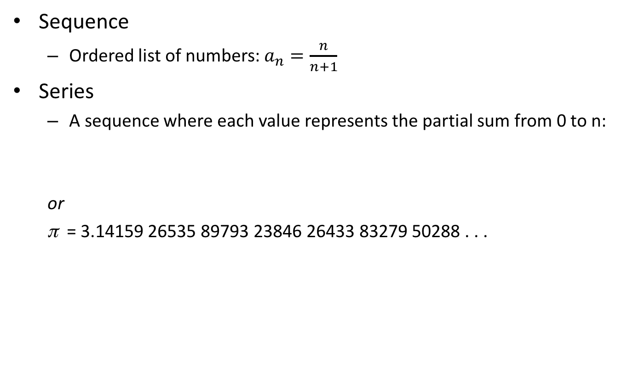
Definitions
Sequence
Ordered list of numbers: $a_{n}=\frac{n}{n+1}$
Series
A sequence where each value represents the partial sum from 0 to n:
or
π = 3.14159 26535 89793 23846 26433 83279 50288 . . .
Infinite series have applications in Fourier analysis (IMINT & SIGINT, compression techniques), cell phones (GSM, CDMA) and cryptology (NSA) to name a few

Slide 3
Road ahead
Series Convergence Strategy (11.7)
Divergence Test (11.2)
Test p-series or geometric (11.2/3)
Comparison Test (11.4)
Alternating Series Test (11.5)
Ratio Test (11.6)
Root Test (11.6)
Integral Test (11.3)

Slide 4
Futurama
Accidentally frozen, pizza-deliverer Fry wakes up 1,000 years in the future. He is taken in by his sole descendant, an elderly and addled scientist who owns a small cargo delivery service. Among the other crew members are Capt. Leela, accountant Hermes, intern Amy, obnoxious robot Bender and lobster like moocher "Dr." Zoidberg.

Slide 5
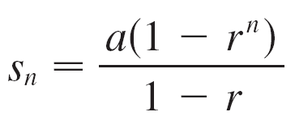
Geometric Series
A geometric series is one in which each term is a constant multiple of the previous term.
Finite:
Notes:
Understand that r can be negative or a function
“a” is the first term

Slide 6
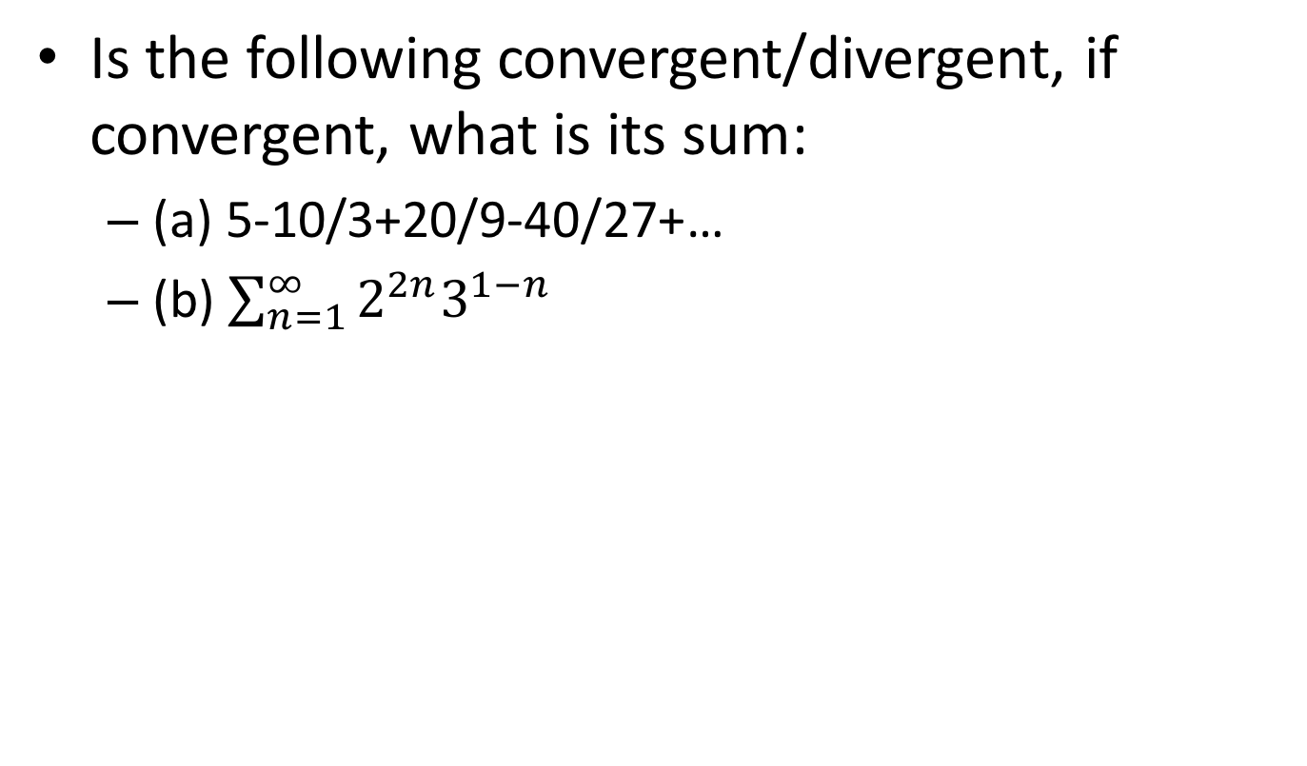
Examples
Is the following convergent/divergent, if convergent, what is its sum:
(a) 5-10/3+20/9-40/27+…
(b) $\sum_{n=1}^{∞}{2^{2n}3^{1−n}}$
Convergent: 3
Divergent

Slide 7
Series Convergence
The converse of Theorem 6 is not true in general!
If lim_{n→} a_{n} = 0, we cannot conclude that Σ a_{n} is convergent.
Not super useful

Slide 8
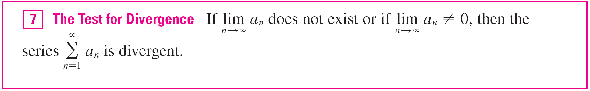

Series Divergence
The Test for Divergence follows from Theorem 6 because, if the series is not divergent, then it is convergent, and so
lim_{n →} a_{n} = 0.

Slide 9
Properties of Convergent Series

Slide 10
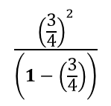
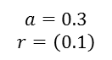
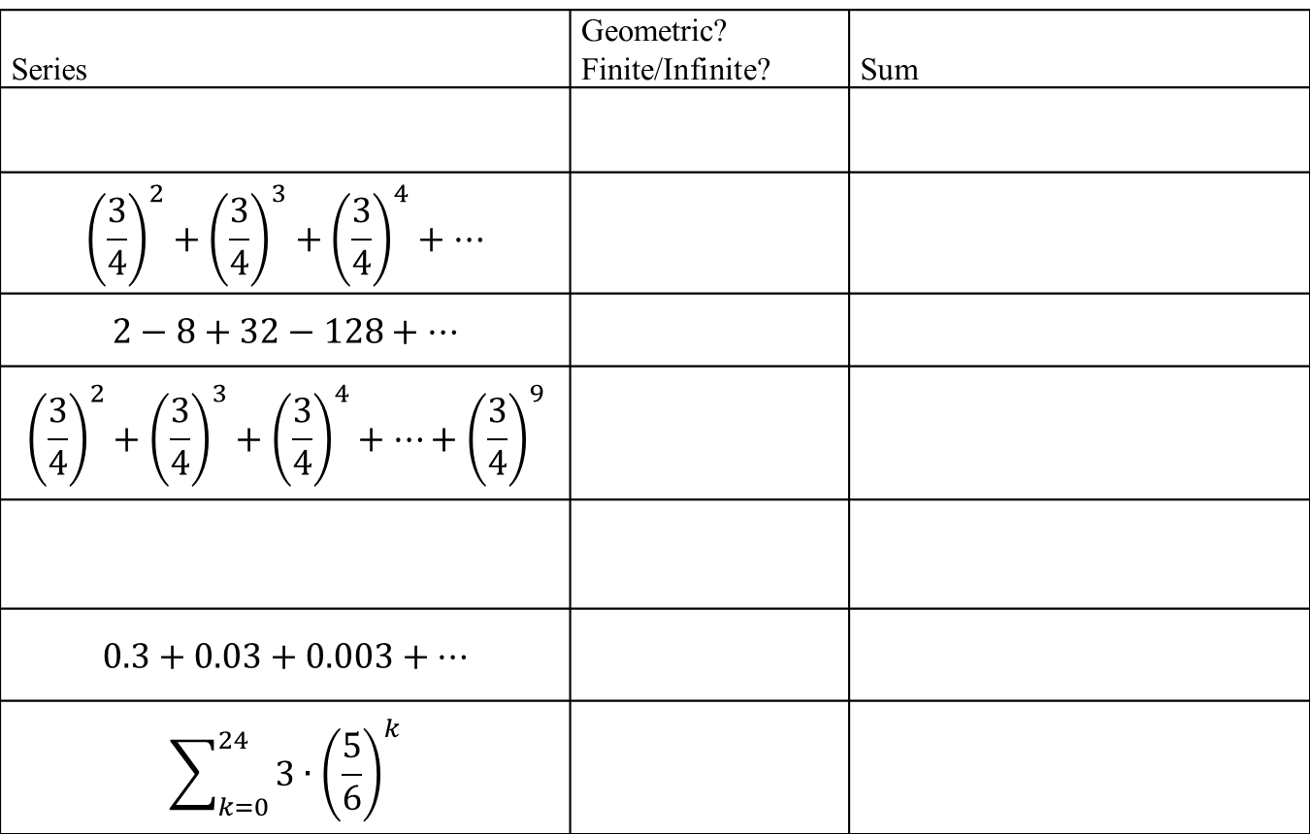
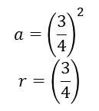
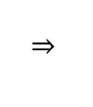
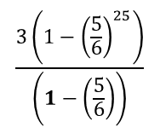
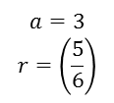
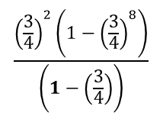
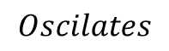
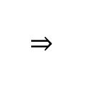
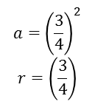
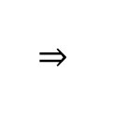
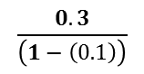
Board Work
Series | Geometric? Finite/Infinite? | Sum
$${\left(\frac{3}{4}\right)}^{2}+{\left(\frac{3}{4}\right)}^{3}+{\left(\frac{3}{4}\right)}^{4}+⋯$$
$$2−8+32−128+⋯$$
$${\left(\frac{3}{4}\right)}^{2}+{\left(\frac{3}{4}\right)}^{3}+{\left(\frac{3}{4}\right)}^{4}+⋯+{\left(\frac{3}{4}\right)}^{9}$$
$$0.3+0.03+0.003+⋯$$
$$\sum_{k=0}^{24}{3∙{\left(\frac{5}{6}\right)}^{k}}$$
$$a={\left(\frac{3}{4}\right)}^{2}$$
$$r=\left(\frac{3}{4}\right)$$
$$\frac{{\left(\frac{3}{4}\right)}^{2}}{\left(1−\left(\frac{3}{4}\right)\right)}$$
G / Infinite
G / Infinite
$$Oscilates$$
$$a={\left(\frac{3}{4}\right)}^{2}$$
$$r=\left(\frac{3}{4}\right)$$
$$\frac{{\left(\frac{3}{4}\right)}^{2}\left(1−{\left(\frac{3}{4}\right)}^{8}\right)}{\left(1−\left(\frac{3}{4}\right)\right)}$$
G / Finite
$$a=0.3$$
$$r=\left(0.1\right)$$
$$\frac{0.3}{\left(1−\left(0.1\right)\right)}$$
G / Infinite
$$a=3$$
$$r=\left(\frac{5}{6}\right)$$
$$\frac{3\left(1−{\left(\frac{5}{6}\right)}^{25}\right)}{\left(1−\left(\frac{5}{6}\right)\right)}$$
G / Finite
Notes:
“+…” is infinite
1.0/0.5 = 2, 1.5/1.0=1.5, therefore NOT geometric $a_{n}$ = (0.5)n, the limit as n approaches infinity DNE
$a={\left(\frac{3}{4}\right)}^{2}$ because the summation is from 0 to INF (not 1 to INF) for the convergence to $\frac{a}{1−r}$ to work
a = 2, r = -4. abs(r) = abs(-4) = 4 which is >1, therefore NOT convergent
$the first term, a={\left(\frac{3}{4}\right)}^{2}$ , and $r=\left(\frac{3}{4}\right), but the series is finite with first 8 terms,$so use $S_{n}=\frac{a(1−r^{n})}{(1−r)}$
$a_{n}$ = 1/n. Although $a_{n}$ itself converges to 0, the “series” diverges (p708, example 8)
25 terms (0 to 24)

Slide 11
Backups

Slide 12
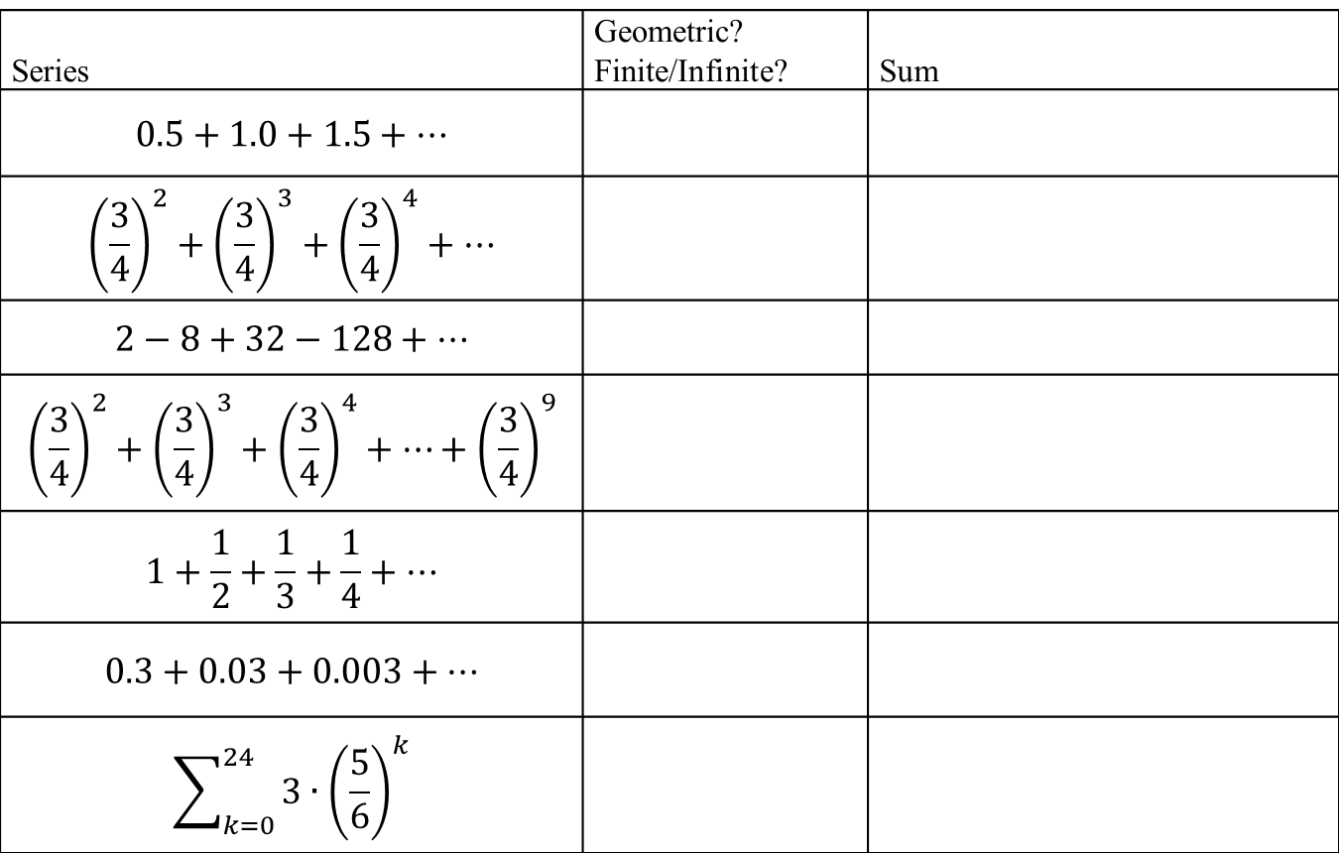


Board Work
Series | Geometric? Finite/Infinite? | Sum
$$0.5+1.0+1.5+⋯$$
$${\left(\frac{3}{4}\right)}^{2}+{\left(\frac{3}{4}\right)}^{3}+{\left(\frac{3}{4}\right)}^{4}+⋯$$
$$2−8+32−128+⋯$$
$${\left(\frac{3}{4}\right)}^{2}+{\left(\frac{3}{4}\right)}^{3}+{\left(\frac{3}{4}\right)}^{4}+⋯+{\left(\frac{3}{4}\right)}^{9}$$
$$1+\frac{1}{2}+\frac{1}{3}+\frac{1}{4}+⋯$$
$$0.3+0.03+0.003+⋯$$
$$\sum_{k=0}^{24}{3∙{\left(\frac{5}{6}\right)}^{k}}$$
NG / Infinite
$$∞$$
$$a={\left(\frac{3}{4}\right)}^{2}$$
$$r=\left(\frac{3}{4}\right)$$
$$\frac{{\left(\frac{3}{4}\right)}^{2}}{\left(1−\left(\frac{3}{4}\right)\right)}$$
G / Infinite
G / Infinite
$$Oscilates$$
$$a={\left(\frac{3}{4}\right)}^{2}$$
$$r=\left(\frac{3}{4}\right)$$
$$\frac{{\left(\frac{3}{4}\right)}^{2}\left(1−{\left(\frac{3}{4}\right)}^{8}\right)}{\left(1−\left(\frac{3}{4}\right)\right)}$$
G / Finite
$$∞$$
NG / Infinite
$$a=0.3$$
$$r=\left(0.1\right)$$
$$\frac{0.3}{\left(1−\left(0.1\right)\right)}$$
G / Infinite
$$a=3$$
$$r=\left(\frac{5}{6}\right)$$
$$\frac{3\left(1−{\left(\frac{5}{6}\right)}^{25}\right)}{\left(1−\left(\frac{5}{6}\right)\right)}$$
G / Finite
Notes:
“+…” is infinite
1.0/0.5 = 2, 1.5/1.0=1.5, therefore NOT geometric $a_{n}$ = (0.5)n, the limit as n approaches infinity DNE
$a={\left(\frac{3}{4}\right)}^{2}$ because the summation is from 0 to INF (not 1 to INF) for the convergence to $\frac{a}{1−r}$ to work
a = 2, r = -4. abs(r) = abs(-4) = 4 which is >1, therefore NOT convergent
$the first term, a={\left(\frac{3}{4}\right)}^{2}$ , and $r=\left(\frac{3}{4}\right), but the series is finite with first 8 terms,$so use $S_{n}=\frac{a(1−r^{n})}{(1−r)}$
$a_{n}$ = 1/n. Although $a_{n}$ itself converges to 0, the “series” diverges (p708, example 8)
25 terms (0 to 24)

Slide 14
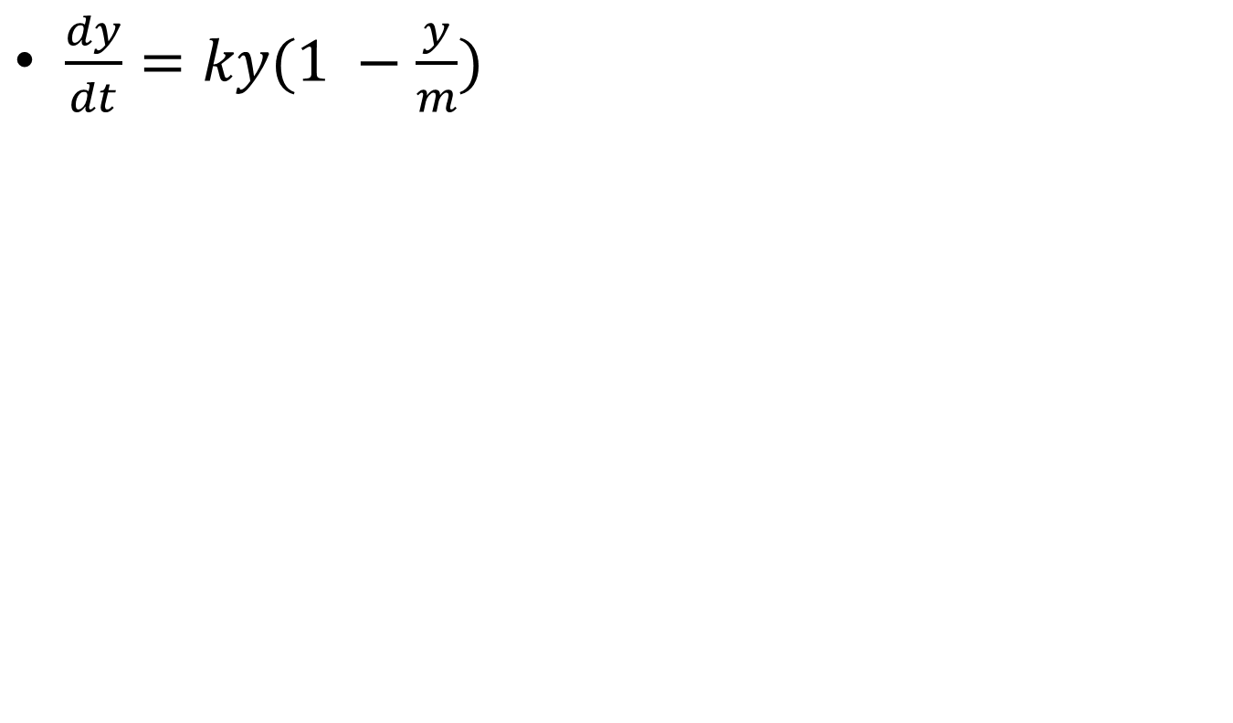
$\frac{dy}{dt}=ky(1 −\frac{y}{m})$
Notes:
9.4 #3) lot’s of “magical leaps” from diffy-q to “y(t) = “

Slide 15
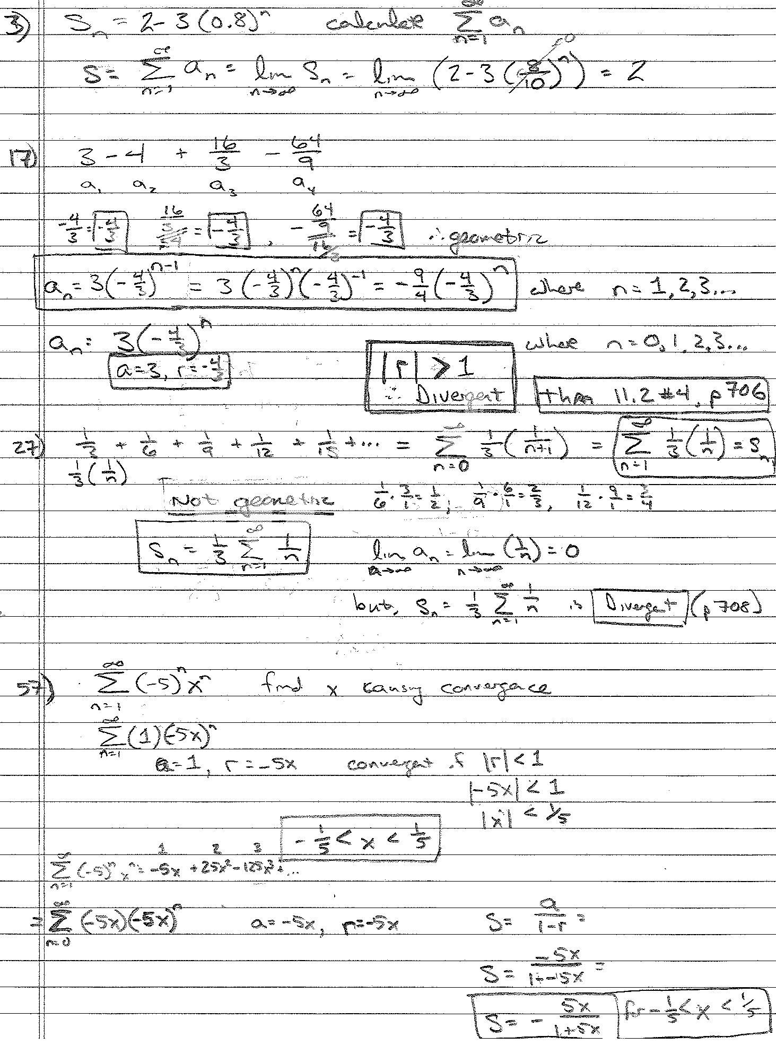

Slide 16
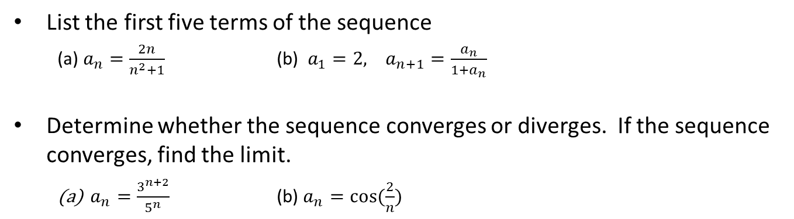
Review
List the first five terms of the sequence
(a) $a_{n}=\frac{2n}{n^{2}+1}$ (b) $a_{1}=2, a_{n+1}=\frac{a_{n}}{1+a_{n}}$
Determine whether the sequence converges or diverges. If the sequence converges, find the limit.
$a_{n}=\frac{3^{n+2}}{5^{n}}$ (b) $a_{n}=\cos{(\frac{2}{n})}$
Notes:
a) Divide by highest power of “n” in the denominator, (2/n) goes to 0 as n goes to infinity, therefore the sequence converges on 0
b) “recursively” defined…like a Fibonacci sequence – 112358…1+1=2, 1+2=3, 2+3=5, 3+5=8…
3^(n+2)/5^n = (3^n)(3^2)/(5^n) = 9(3/5)^n…3/5 < 1, so (3/5)^n converges to zero
As n goes to infinity, (2/n) goes to 0…cos(0) = 1

Slide 17
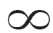
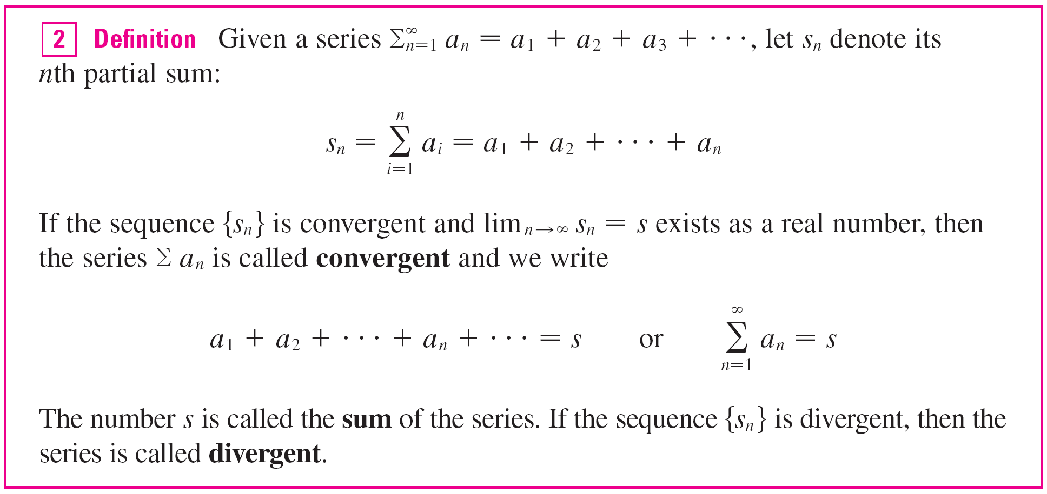
Series
If lim_{n →} s_{n} = s exists (as a finite number), then, as in the preceding example, we call it the sum of the infinite series
Σa_{n}.

